Slide 1

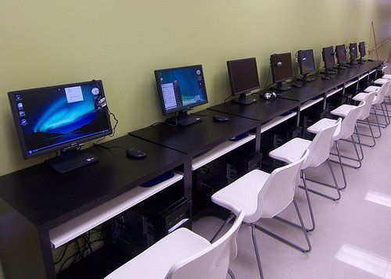

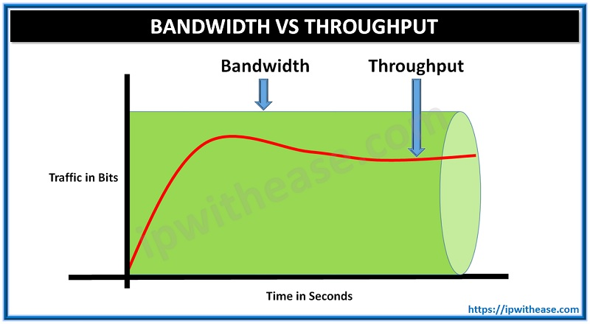
Reviewing the bandwidth and ICT infrastructure used in Internet Cafés for cloud computing.
Kabai Moipone, Mkalali Siphelele
Cape Peninsula University of Technology
¹Department of Information Technology, Cape Peninsula University of Technology
Research Mentor: Dr, Lynn Coleman
Abstract
Methods
Discussions
Developing economic sectors lack ICT infrastructure to fully equip them to be able to use cloud computing services. However, for small businesses to maximize cloud computing benefits, services and devices should be available.
As cloud computing is achieving increased popularity, concerns are being voiced about infrastructural resources’ reliability, accessibility and cost effectiveness. This study will review the reliability and accessibility of resources needed to use cloud computing and the bandwidth of data transmissions from the cloud in small businesses, the Internet Cafés to be specific.
From an application perspective, the type of research we are conducting is an applied research. This is because our research is based on the data that will be collected to understand how the problem is affecting internet cafés.
In an objective perspective, our research is descriptive as we describe the infrastructural resources used in cloud computing and how the bandwidth affects data transmission over a network.
Because “it is usually impossible to include the entire population in your study; the two main restrictions being time and cost” Maree and Pietersen (2016:192), we will use the probability methods for sampling which are based on the principle of randomness and theory.
We used questionnaires to collect data for our study, which is “a written list of questions, the answers to which are recorded by respondents” Kumar (2011:138).
We are conducting our research in internet cafés and we are aiming to get as many responses as possible as we have distributed an online questionnaire for internet cafés to respond to it with a consent form attached.
We are therefore hoping to get as many responses as possible out of the 30 internet cafés we are expecting to get responses from. This will help us understand the variation in infrastructural resources currently put in place depending on many factors like affordability and accessibility in order to access cloud computing resources. “All of the 42 Internet cafe´s studied experienced varying infrastructural stresses depending on particular geographic contexts” Best and Macaulay (2002).
Introduction
Frankenfield (2020) states that cloud computing is the delivery of different services through the internet which includes tools like data storage, database, networking, and software. Cloud services allow you to save files to a remote database, and you can access them anytime as long as you have internet access.
Before cloud computing can be used, infrastructural resources such as network equipment, computing, power, etc. are needed to give a head start.
However, when the bandwidth “rate at which data is transferred and processed” (Tool et al., 2020) is poor cloud computing will become useless to the end user.
References
Best, M.L., & Macaulay, C. (2002). Community internet access in rural areas: Solving the economicsustainability puzzle, Sari-internet-TRR-2002, Sustainable access in rural India (SARI), Chennai.
Frankenfield, J. 2020. Cloud computing: CLOUD COMPUTING - Running Head. https://www.coursehero.com/file/67474452/CLOUD-COMPUTING-111docx/ [10 October 2020].
Kumar, R. 2011. Research Methodology: A step-by-step guide for beginners. 3rd ed. London: SAGE.

